Slide 1
Single cell sequencing
A short overview of the possibilities

Slide 2
Agenda today
Attendance record on https://forms.gle/cZ8YoNTa9dJQgzGFA
Notes:
https://forms.gle/cZ8YoNTa9dJQgzGFA

Slide 3
Agenda tomorrow

Slide 4
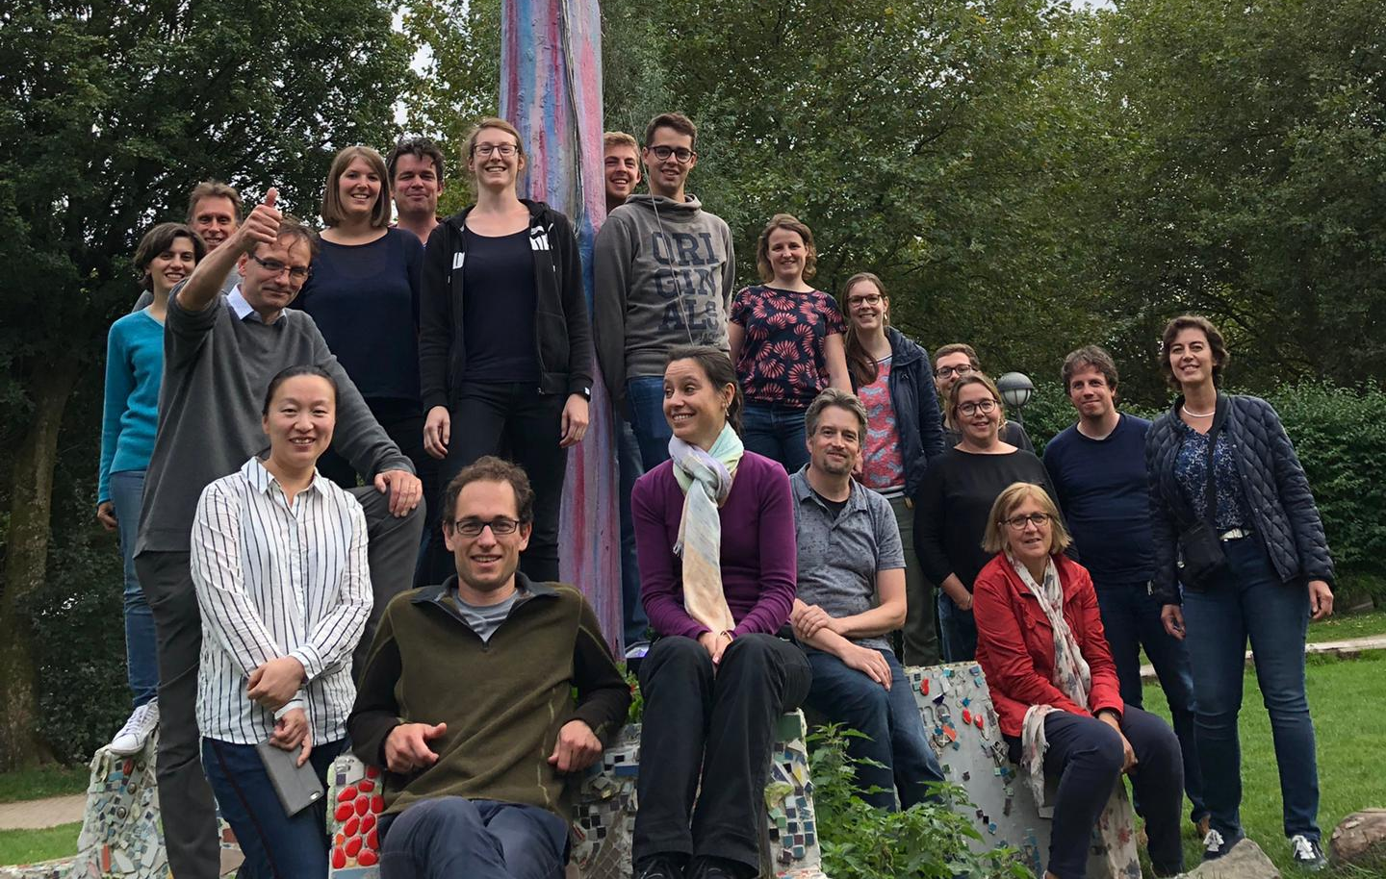
Our mission
Making the NGS accessible for everybody
Implement novel NGS technologies
Reduce cost for NGS by optimizing sequencing
NGS knowledge hub
Diagnose patients

Slide 5
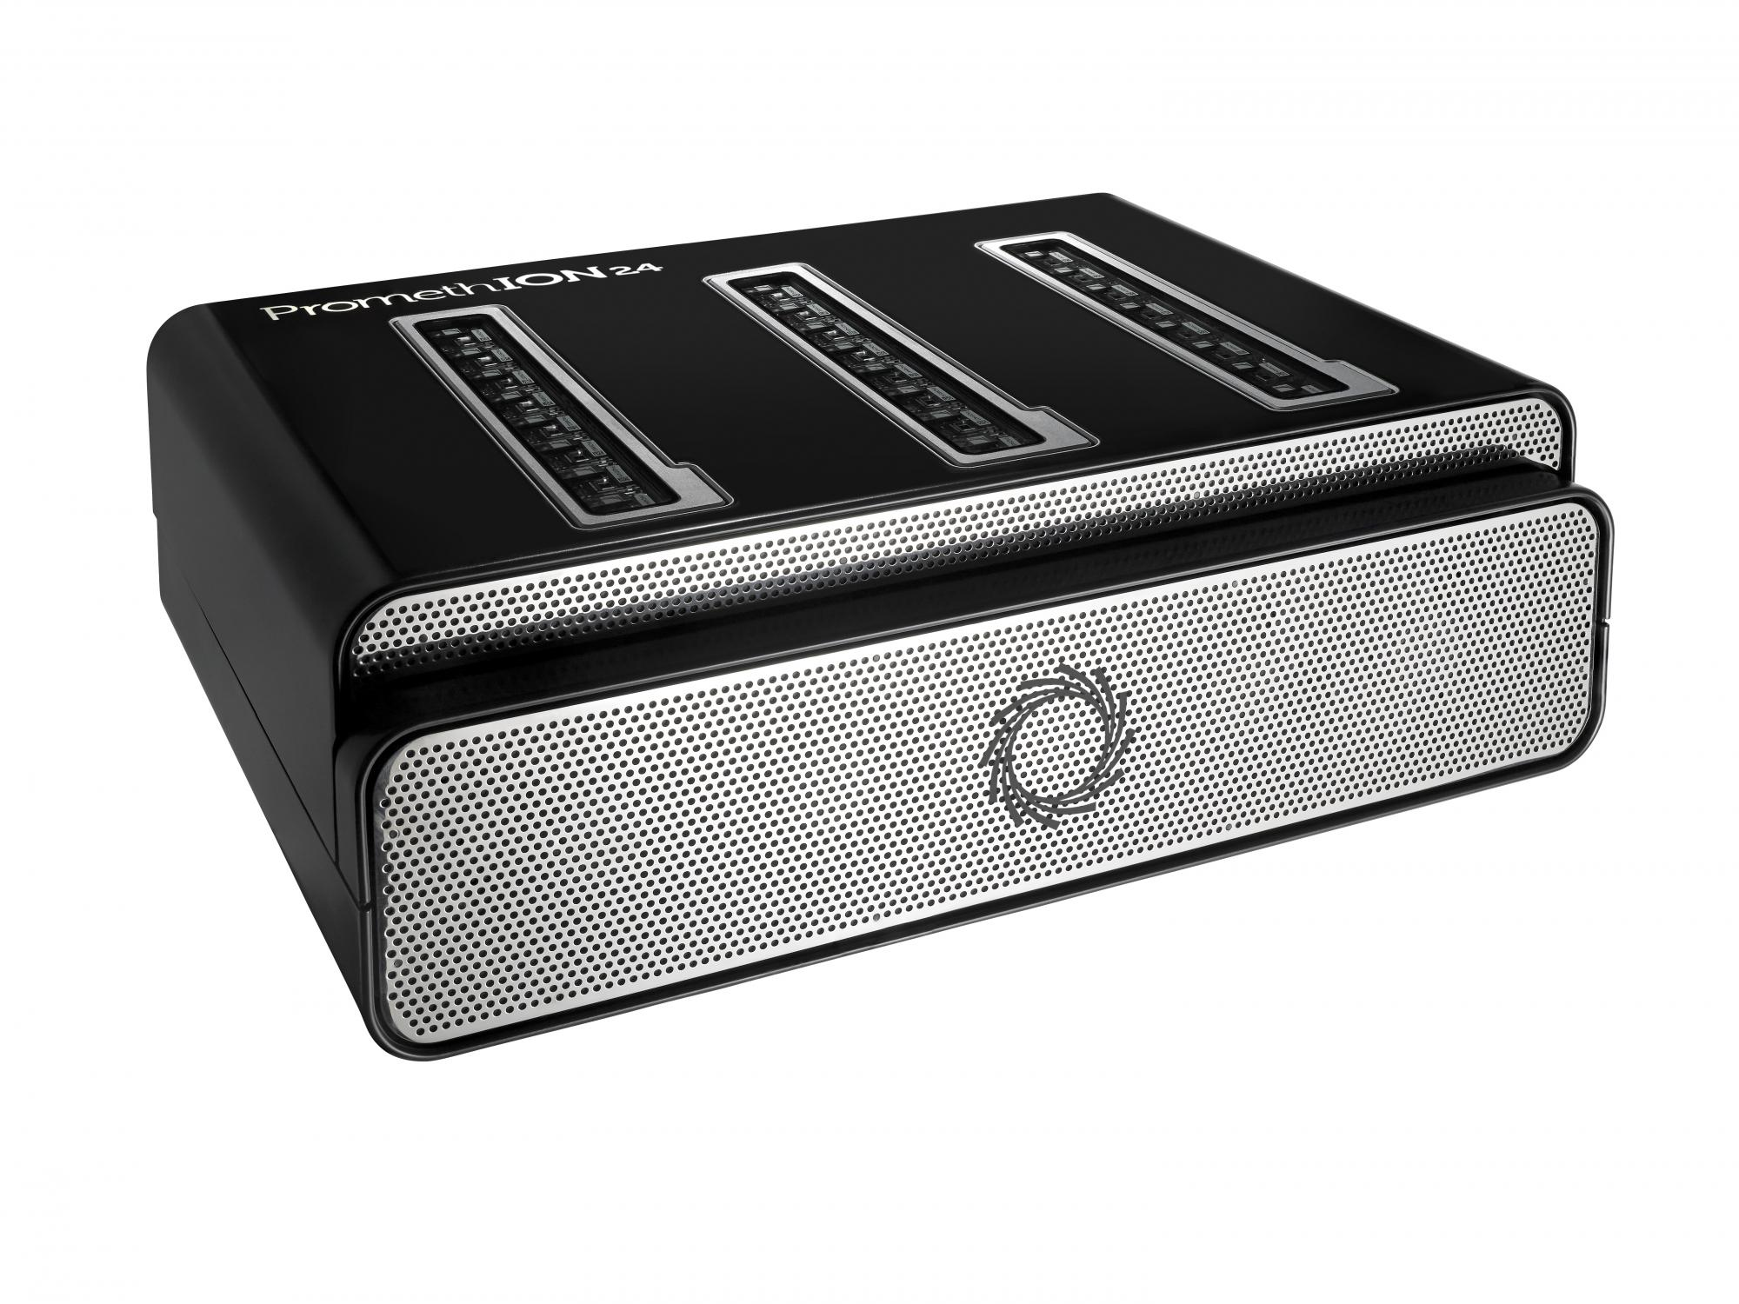
Promethion Startup call
Deadline noon tomorrow!
Samples by end of March
300 word abstract to propose project
8 project get a free flowcell
Only eligible for KULeuven

Slide 6
Genomics Core
DNA
RNA
Single cell genomics
Sequencing only
Bio-informatics

Slide 7
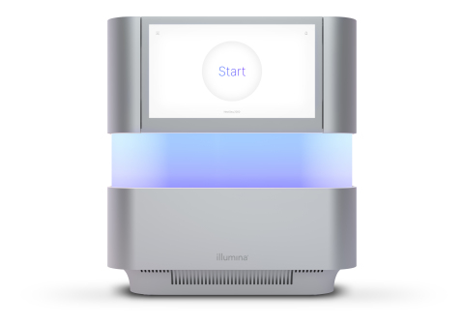
Nextseq2000
Instrument for direct access
Training required (500 euro)
Protocol optimization
Medium sized single cell projects
Cycles | P2 (400M reads) | P3 (1,1B reads)
50 | - | 55 b
100 | 40 Gb | 110 Gb
200 | 80 Gb | 220 Gb
300 | 120Gb | 330 Gb

Slide 8
What is single cell?
Identify genetic information from single cells
Used to detect heterogeneity in a cell population
Applies to a wide range of techniques that have single cell resolution
Genomics
Epigenetic
Transcriptomic
Immune cell profiling
Proteomic
Spatial

Slide 9
transcriptomics

Slide 10
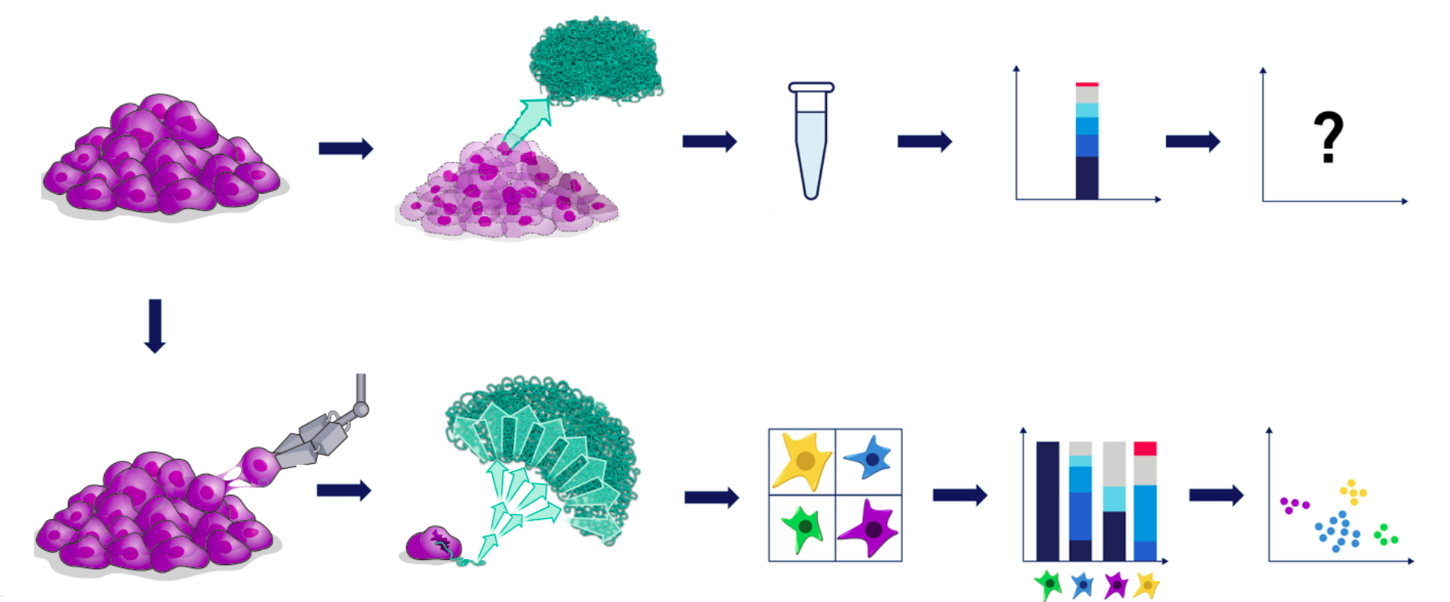
RNAseq: Bulk versus single cell

Slide 11
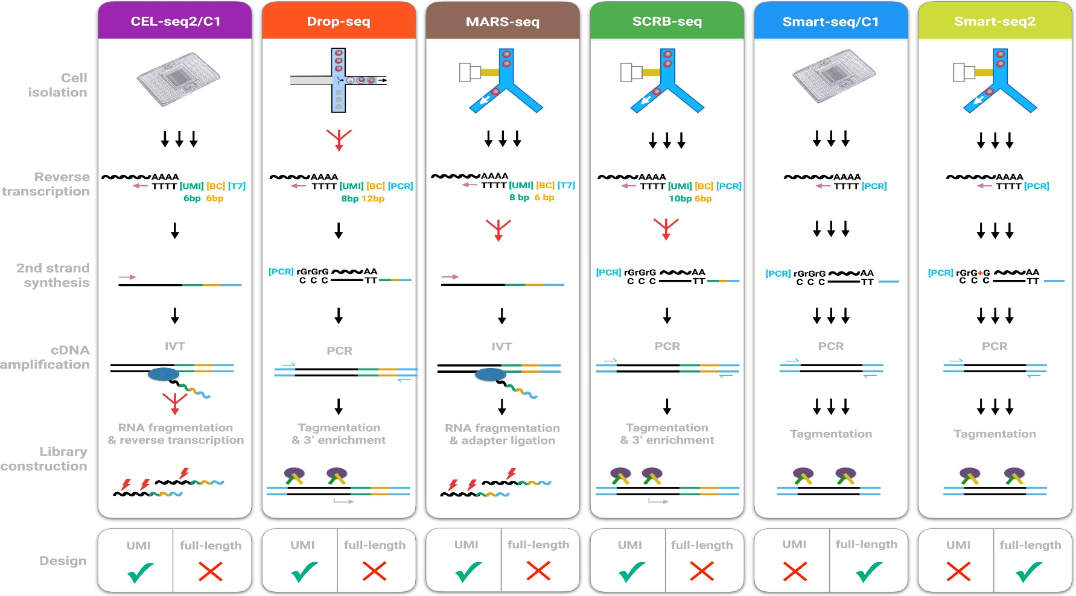
Which method to choose
10x genomics
SMART-seq2

Slide 12
Experimental choices
 | 10x Genomics | SMART-seq2
Collection | Microfluidics | FACS
Number of cells | 500-10000 per run | 96-384
transcripts | 3’ | Full transcript coverage
Type of questions | Cell population dynamics Molecular overview | Deep molecular insight

Slide 13
Smart-seq2 vs 10x Genomics 3’
Wang et al., BioRxiv 2019

Slide 14
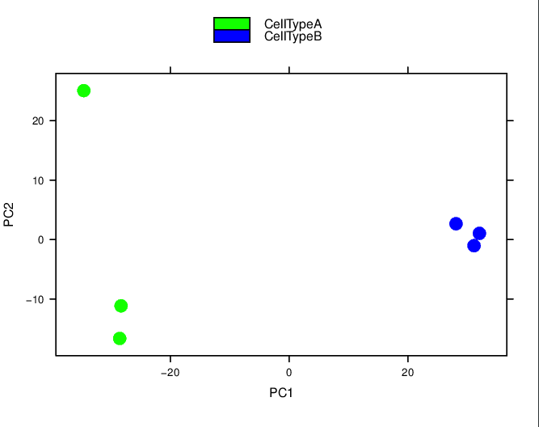
Combined RNAseq and 10x
Combine Lexogen Quantseq on a population of samples
Followed by 10x Genomics single nuclei transcription analysis
Benefits:
QC of RNA quality of cells
Identify variation in a population of samples (if you can get enough)
Pick representative sample for single cell analysis
Inform on number of cells and sequencing depth of 10x

Slide 15
epigenetics

Slide 16
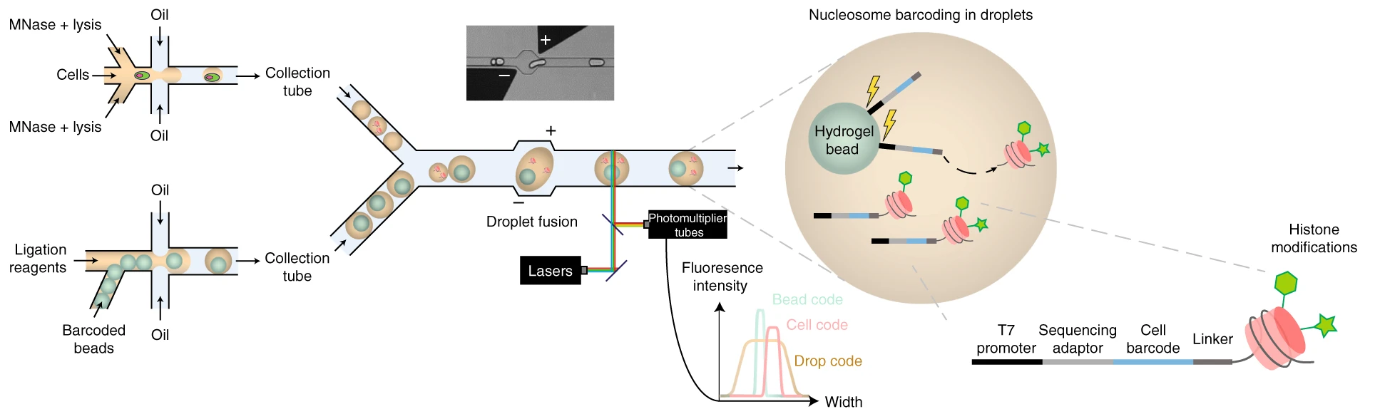
Single cell epigenetics
Histone modifications
Drop-chip or variants
Single cell epigenetic
Notes:
Cut between histones with Mnase, ligate unique oligos, break droplets and CHIP histone modifications

Slide 17
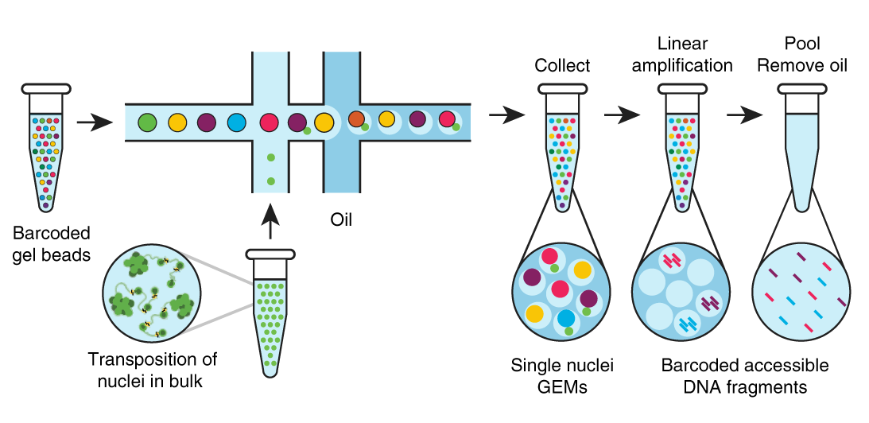
Single cell epigenetics
Histone modifications
Drop-chip or variants
Chromatin accessibility
scATAC-seq
Single cell epigenetic
Notes:
Tn5 transposase cleaves and incorporates unique barcodes in open chromatin

Slide 18
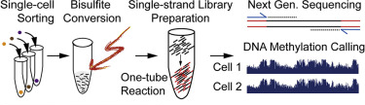
Single cell epigenetics
Histone modifications
Drop-chip or variants
Chromatin accessibility
scATAC-seq
Single cell epigenetic
DNA methylation
Bisulfite treated barcoded libraries

Slide 19
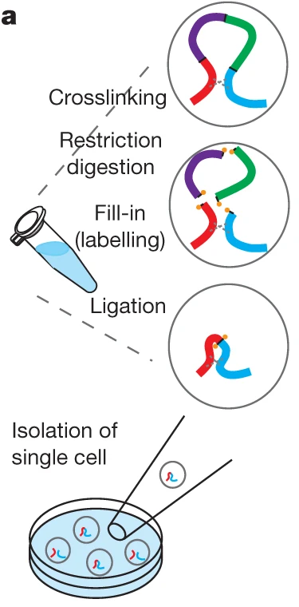
Single cell epigenetics
Single cell epigenetic
Histone modifications
Chromatin accessibility
DNA methylation
Chromatin structure
Drop-chip or variants
scATAC-seq
Bisulfite treated barcoded libraries
Single cell Hi-C
Notes:
Hi-C: Chromatin crosslinking, restriction enzyme (BglII or DpnII) digestion, biotin fill-in and ligation were performed in nuclei

Slide 20
genomics

Slide 21
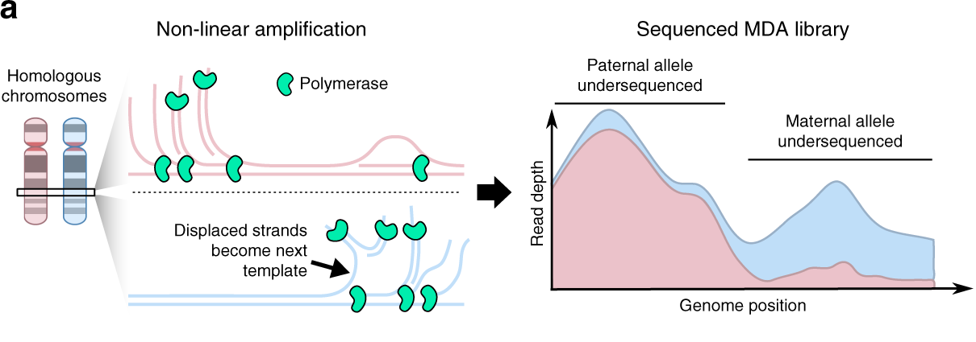
Single cell Genomics
Just two alleles per cell
WGA causes allelic imbalance
Early artefacts are amplified, VAF variability
SNV detection must compensate for artefacts
CNV detection needs sparser coverage

Slide 22
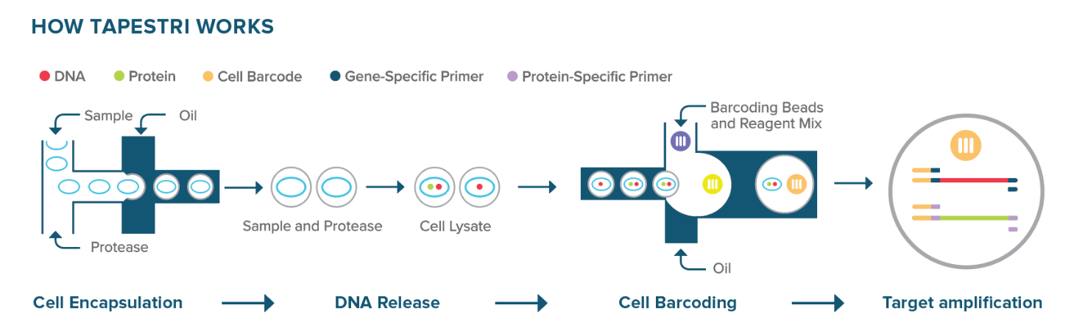
Single cell DNA sequencing
FACS-based methods
Mission Bio Tapestri
Genome-wide
More noise
Low throughput
CNV detection
SNV detection possible
Pre-designed panels
Quite sensitive
‘high’ throughput
SNV detection

Slide 23
Immune cell profiling

Slide 24
10x immune cell
Amplify VDJ and make libraries
Amplify cDNA
Amplify feature barcode of antibody
In GEMs: Capture RNA and feature barcodes on antibodies, convert to cDNA

Slide 25
combinatorial

Slide 26
Combining different technologies
10x out of the box
Transcriptome and ATAC
Immune and feature barcoding
10x not so much out of the box
Transcriptome, VDJ, feature barcoding (multiple)
Any 10x with feature barcoding (antibodies, cell hashing,…)
G&T-seq
Combining techologies

Slide 27
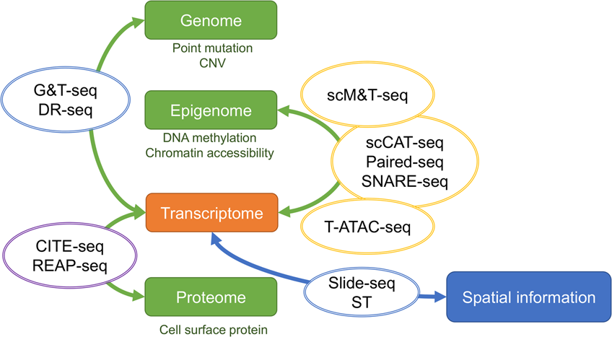
Kashima et al., Exp Mol Med (2020)
Notes:
Paired-seq and Snare-seq: atac-seq and capture of mRNA through splint oligo’s or ligation

Slide 28
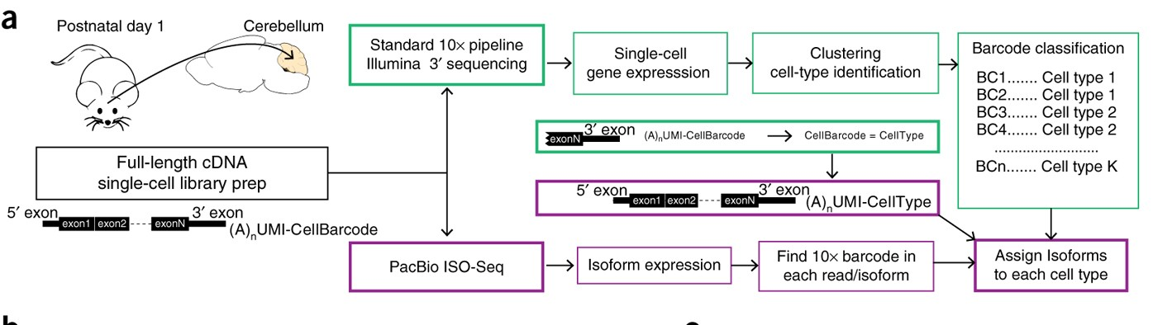
ScISOr-seq

Slide 29
ScNaUmi-seq

Slide 30
Thanks!
Any questions in the chat?

